Slide 1
Non Linear and Efficient RF Energy
Harvesting for Backscatter Sensor Network
with Extended Communication Range
UNDER THE GUIDANCE OF
DR D GHOSH
PRESENTED BY
MANDEEP MALIK

Slide 2
CONTENTS
Introduction
Literature Survey
Non Linear Energy Harvesting Models
Passive RFID
Scatter Radio Network
Results
Conclusion and Future Work

Slide 3
Introduction
Internet of Technologies (IoT)
Global network infrastructure composed by a variety of devices interacting with each other through the Internet [1].
Fit to customer demands.
IoT applications [1-3]:
Transportation and smart vehicles.
Precision agriculture.
Environmental sensing.
Healthcare.
By 2020: 212 billion IoT devices[1].
By 2025: 2.7–6.2 trillion $[1].
[1] L. Atzori, A. Iera, and G. Morabito, “The internet of things: A survey,” Computer networks, 2010.
[2] L. Da Xu, W. He, and S. Li, “Internet of things in industries: A survey,” IEEE Trans. Ind. Informat., 2014.
[3] A. Al-Fuqaha et al.“Internet of things: A survey on enabling technologies, protocols, and applications,” IEEE Commun. Surveys Tuts., 2015.

Slide 4
Introduction
Sensing
Wireless
sensors
Services
Semantics
CONFIDENTIALITY
ENCRYPTION
Industrial application
“The Internet of Things is not a concept; it is a network, the true technology-enabled Network of all networks[2].” – Edewede Oriwoh
Analysis
IoT
Cloud
RFID
Identification
Computation
Low power
Communication

Slide 5
Introduction
RF Energy Harvesting
Remote ambient or dedicated power source[4]
Simultaneous wireless information and power transfer (SWIPT)
Power for ultra-low-power devices[4]
Rectenna (Antenna and Rectifier)[5]
Diodes, Efficiency, Sensitivity[4]
Communication sensitivity [6]
-40dBm (Low BW radios)
-85dBm [4](High BW GSM Cell phones)
Harvester sensitivity at -30dBm[6]
Gap of 55 dBm to 120 dBm
[4] Panos N. Alevizos and Aggelos Bletsas, “Sensitive and Nonlinear far field RF energy harvesting in wireless communication”, IEEE transactions on wireless communication, vol 2, 2018.
[5] G. D. Durgin, “RF thermoelectric generation for passive RFID," in RFID, 2016 IEEE International Conference on. IEEE, 2016, pp. 1-8.
[6] K. Huang and E. Larsson, “Simultaneous information and power transfer for broadband wireless systems “, IEEE Transactions on Signal Processing, vol. 61, no. 23, pp. 5972-5986}, 2013.

Slide 6
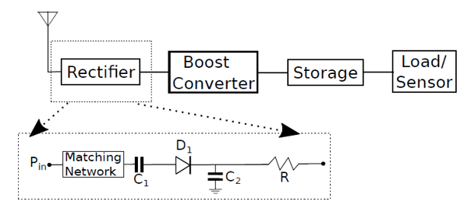
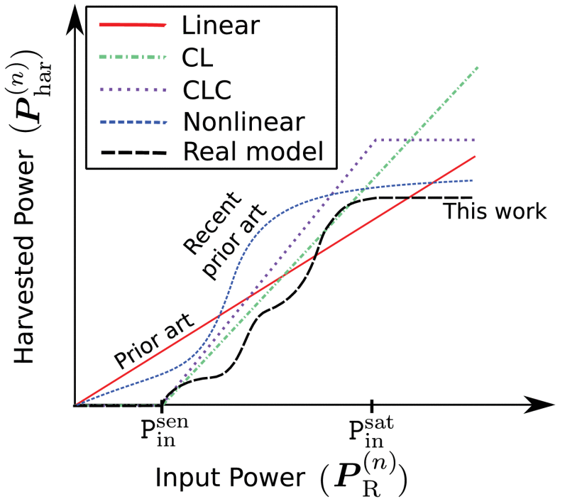
Introduction
Problem Statement (1/2)
Diodes in rectifier circuit.
Strong nonlinearities on power conversion.
Sensitivity and Saturation effects.
Prior articles in wireless communication used linear models i.e. Linear, CL and CLC models
Comparison of Non Linear Models
This work offered accurate nonlinear energy harvesting analysis .
[4] Panos N. Alevizos and Aggelos Bletsas, “Sensitive and Nonlinear far field RF energy harvesting in wireless communication”, IEEE transactions on wireless communication, vol 2, 2018.
[7] I. Krikidis, S. Timotheou, S. Nikolaou, G. Zheng, D. W. K. Ng, and R. Schober, “Simultaneous wireless information and power transfer in modern communication systems ”, IEEE Communications Magazine, vol. 52, no. 11, pp. 104-110, 2014.

Slide 7
Introduction
Overall Contribution
Non Linear RF Energy harvesting vis a vis Linear Models i.e. L,CL,CLC
Case study on semi-passive and passive RFID tags
Comparison of Non Linear RF Energy Harvesting Models and performance in different Fading Environment i.e. LoS, N-LoS
Network of RFIDs in Monostatic and Multistatic topologies to extended range in a small scale fading environment
Enhance ultra-low-power IoT technology exploiting novel
concepts in wireless communications and networking.

Slide 8
Introduction
Dissertation Objectives
Enhance ultra-low-power IoT technology exploiting novel concepts in wireless communications and networking.
Objectives :
Accurate RF energy harvesting analysis.
Comparison of Non Linear Energy Harvesting Models.
Performance analysis of Non linear models in small scale fading environment.
BER calculation and outage analysis.
Study of Passive RFIDs
RFID network architecture i.e. Monostatic and Multistatic
Flexible, scatter radio network architecture with extended coverage.

Slide 9
Literature Survey
L. R. Varshney, “Transporting information and energy simultaneously”, in Proc. IEEE Int. Symp. on Inform. Theory (ISIT), Toronto, Canada, 2008, pp. 1612–1616.
P. Grover and A. Sahai, “Shannon meets Tesla: Wireless information and power transfer,” in Proc. IEEE Int. Symp. on Inform. Theory (ISIT), Austin, TX, 2010, pp. 2363–2367.
E. Boshkovska, D. W. K. Ng, N. Zlatanov, and R. Schober, “Practical non-linear energy harvesting model and resource allocation for SWIPT systems,” IEEE Commun. Lett., vol. 19, no. 12, pp. 2082–2085, Dec. 2015.
S. D. Assimonis, S.-N. Daskalakis, and A. Bletsas, “Sensitive and efficient RF harvesting supply for batteryless backscatter sensor networks,” IEEE Trans. Microw. Theory Techn., vol. 64, no. 4, pp. 1327–1338, Apr. 2016.
PowerCast Module, http://www.mouser.com/ds/2/329/P2110B Datasheet-Rev-3-1091766.pdf.
A. Al-Fuqaha, M. Guizani, M. Mohammadi, M. Aledhari, and M. Ayyash, Internet of things: A survey on enabling technologies, protocols, and applications," IEEE Communications Surveys & Tutorials, vol. 17, no. 4, pp. 2347,2376, 2015.

Slide 10
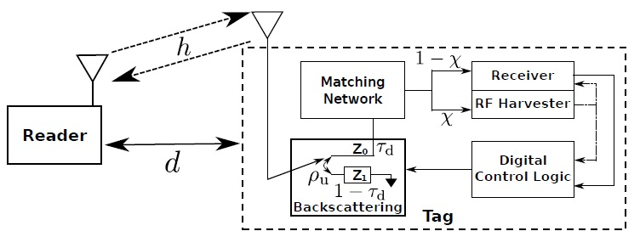


Non Linear Energy Harvesting Models
System Model
Path loss model [8]
Received power at RFID
Harvested power as a function of input power [4]
Harvesting Efficiency function
(1)
(2)
(3)
Where,
(4)
$d_{0}$ = Reference distance
$P_{R}$ = Transmit power of Reader
$$P_{in}=Received power at Tag$$
[4] Panos N. Alevizos and Aggelos Bletsas, “Sensitive and Nonlinear far field RF energy harvesting in wireless communication”, IEEE transactions on wireless communication, vol 2, 2018.
[8] A. Goldsmith, Wireless communications. Cambridge university press, 2005.

Slide 11
Non Linear Energy Harvesting Models
Comparison of Non Linear Models
Non Linear Normalized with and without sensitivity [9] [10].
Second order Polynomial with and without sensitivity [11]
Piecewise Linear Model
Linear Models
L
CL
(5)
(6)
(7)
(8)
(9)
[9] E. Boshkovska, D. W. K. Ng, N. Zlatanov, and R. Schober, “Practical non-linear energy harvesting model and resource allocation for SWIPT systems,” IEEE Commun. Lett., vol. 19, no. 12, pp. 2082–2085, Dec.2015.
[10] S. Wang, M. Xia, K. Huang, and Y. C. Wu, “Wirelessly powered two-way communication with nonlinear energy harvesting model: Rateregions under fixed and mobile relay,” IEEE Trans. Wireless Commun.,vol. 16, no. 12, pp. 8190–8204, Dec. 2017.
[11]X. Xu, A. ¨Ozcelikkale, T. McKelvey, and M. Viberg, “Simultaneous information and power transfer under a non-linear RF energy harvesting model,” in Proc. IEEE Int. Conf. Communications, Paris, France, May2017, pp. 179–184.

Slide 12

Passive RFID
RFID Operation
Power solely dedicated for energy harvesting.
Input power for communication is
Minimum power for RFID operation
Power for uplink
FM0[12] line coding is used
Balance time for absorbing and reflection
Avoid ghost Tag reception in case of Reader
Observe 2T signal duration for each bit of duration T
(10)
(11)
Where,
Time connected to
Time connected to
Input power for harvesting X
(12)
$$Z_{1}$$
(13)
[12] N. Kargas, F. Mavromatis, and A. Bletsas, “Fully-coherent reader with commodity SDR for Gen2 FM0 and computational RFID,” IEEE Wireless Commun. Lett., vol. 4, no. 6, pp. 617–620, Dec. 2015.

Slide 13
Passive RFID
Outage Analysis
Successful RFID Operation
Input RF power is above Harvester Sensitivity
Harvested Power is above Tags Power Consumption
BER at the Reader is below a Threshold
Outage due to Limited Harvester Sensitivity
Signals useful for communication may not be useful for power transfer
Outage due to Limited Power Consumption
Fading and input power at Tag
Type of RF harvester
Tag’s Power consumption
(14)
(15)

Slide 14
Passive RFID
Outage Analysis
Information Outage
Probability of Unsuccessful Reception
If any of the even A,B or C takes place than reception is unsuccessful
Combined Probability of unsuccessful reception
Probability of Successful Reception
(16)
(17)
(18)

Slide 15
Scatter Radio Network
Introduction
Communication by means of Reflection (No Marconi Radios).
Viable ultra low power solution for WSNs and IoT [13].
Low monetary cost
Limited Forward Link range
Applications :
Electronic Ticketing
Logistics Management
Smart Inventory
Health Care
[13] G. Vannucci, A. Bletsas, and D. Leigh, “A software-defined radio system for backscatter sensor networks,” IEEE Trans. Wireless Commun., vol. 7, no. 6, pp. 2170–2179, Jun. 2008.

Slide 16
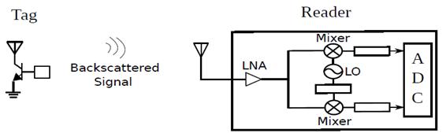
Scatter Radio Network
Problem Statement (2/2)
Inherent problems:
Large path-loss attenuation = Limited range.
Passive tags ⇒ Powering issues ⇒ Limited range.
High bitrate ⇒ Reduced energy per bit ⇒ Limited range.

Slide 17
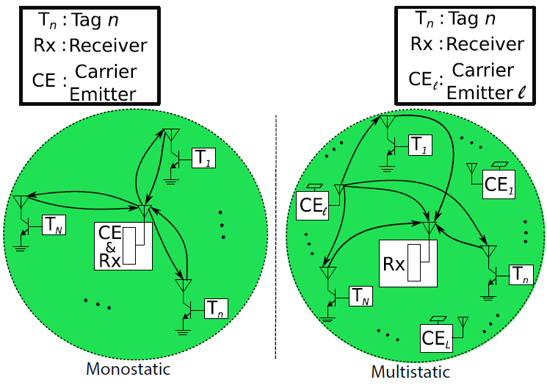
Scatter Radio Network
Network Architecture
Mono-static
Reader and CE are same
Low coverage
Multi-static
Single Reader and multiple Emitter
Deployed for large area
Multiple Access
TDMA
FDMA

Slide 18
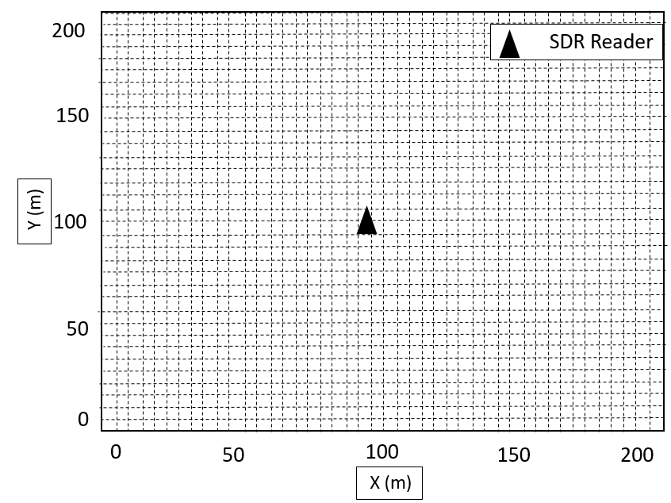
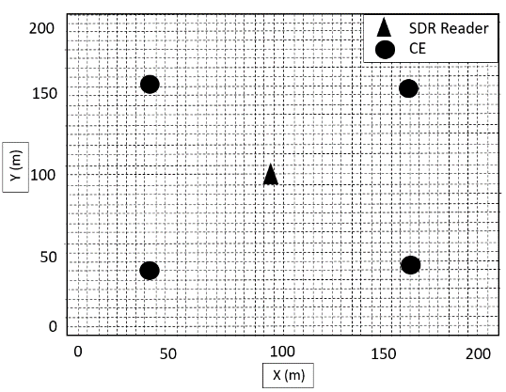
Scatter Radio Network
Channel Model
Nakagami Fading considered
Mono-static case
Same oscillator for CE and Reader
CFO and Frequency offset are zero
Avg energy per bit
No dependence on time index
SNR :
Multi-static case
Different oscillator for CE and Reader
Dependence on time index
Avg energy per bit
SNR
Where,

Slide 19
Scatter Radio Network
BER Analysis
Coherent detection
Mono-static case
Unconditional BER
BER depends on SNR which depends on avg energy and further on tag location, thus finally on topology only.
Proposition 1
Under Rayleigh fading BER decays inversely proportional with the square root of SNR at high SNR regime.

Slide 20
Scatter Radio Network
BER Analysis
Multi-static case
Unconditional BER
BER here also depends on network topology
Multi-static case
Under Rayleigh fading multi-static BER drops faster compared to mono-static at high SNR i.e. decay is faster here.
Non Coherent detection
Under perfect CFO estimation and correction BER performance under non-cohenrent envelope detection is same as coherent.

Slide 21
Scatter Radio Network
Information Outage Analysis
Adjacent Ch Interference
Mono-static SINR
Spectral efficiency of modulation scheme.
Proposition 2
Depends on tag location, network topology (avg energy) and subcarrier frequency assignment.

Slide 22
Scatter Radio Network
Information Outage Analysis
Multi-static SINR
For given subcarrier frequency assignment SINR will be :
Proposition 3
Outage probability under Rayleigh fading
Depends on tag location, network topology (avg energy) and subcarrier frequency assignment (C) and slot (l), since different CE per slot.

Slide 23
Scatter Radio Network
Diversity Reception
Mono-static SINR
Multi-static SINR

Slide 24
Scatter Radio Network
Energy Outage Analysis
Received power at Tag for fixed CE, Tag n and Reader on lth time slot
EO at Tag n
Avg EO and worst case EO

Slide 25
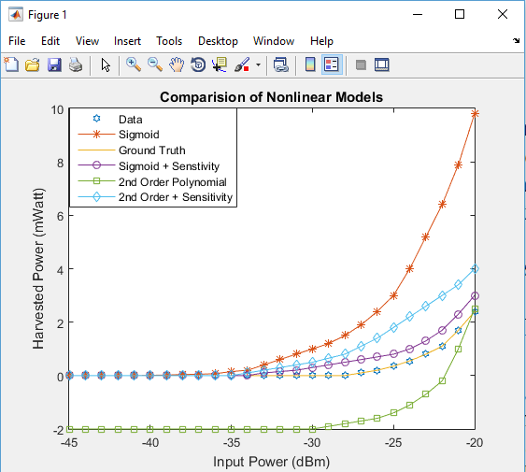
Results
Comparison of Non Linear models

Slide 26
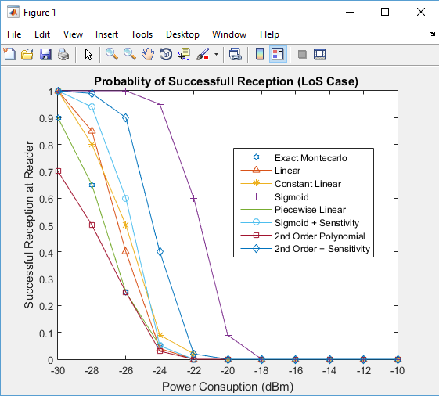
Results
Comparison of Non Linear models

Slide 27
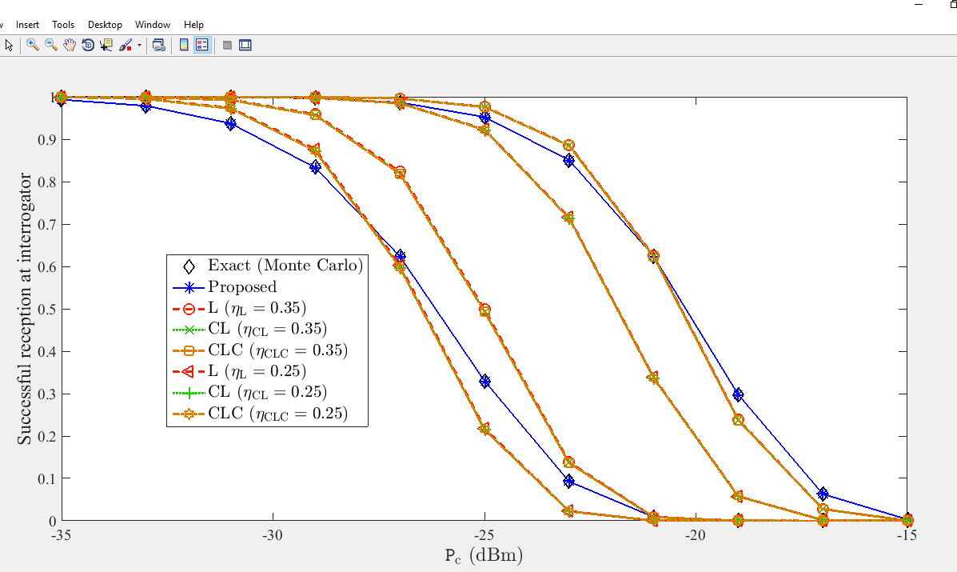
Results
Comparison of Non Linear models

Slide 28
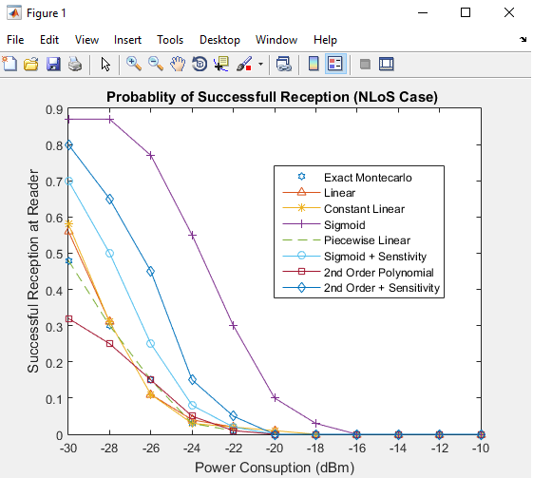
Results
Comparison of Non Linear models

Slide 29
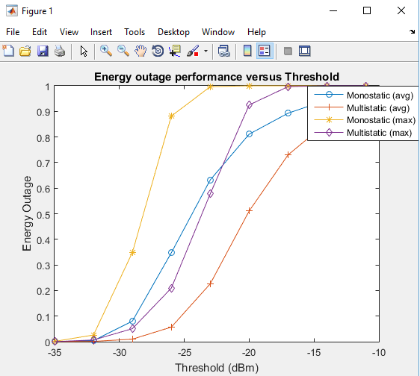
Results
Energy Outage Performance

Slide 30
Results
BER Analysis

Slide 31
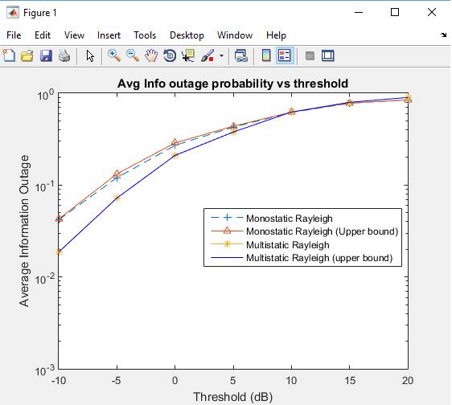
Results
Information Outage (Rayleigh)

Slide 32
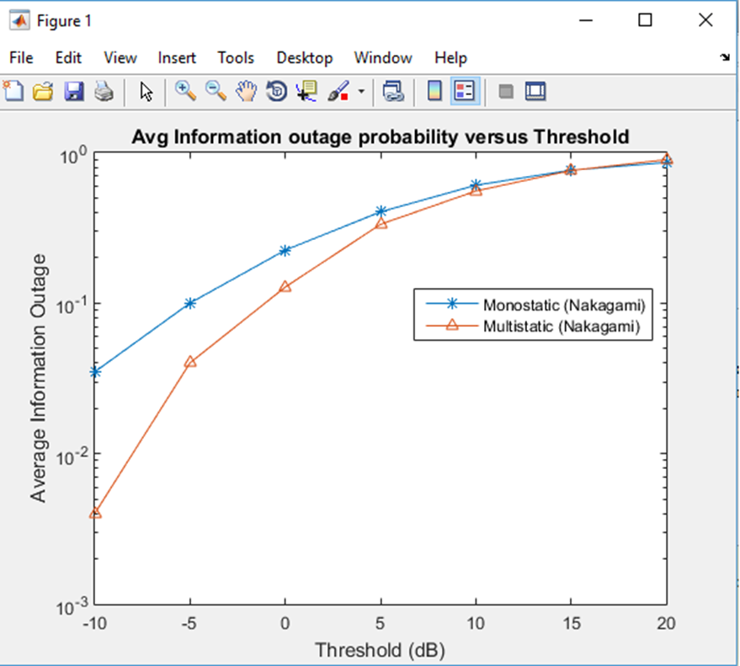
Results
Information Outage (Nakagami)

Slide 33
Results
Information Outage (Nakagami)

Slide 34
Conclusion and Future Work
Efficient and sensitive Non-Linear RF energy harvesting model proposed
Performance of Passive RFID in fading environment examined
Multi-static topology proposed for extended range scatter network
Application in Military logistics, supply chain management and precision agriculture

Slide 35
Contribution
Paper Prepared
[1] Mandeep Malik, Dr D. Ghosh, Smart Military Logistics based on UHF Multi-Static Scatter Radio Network with Non Linear Energy Harvesting.

Slide 36
References
[1] J. Manyika, M. Chui, J. Bughin, R. Dobbs, P. Bisson, and A. Marrs, “Disruptive technologies: Advances that will transform life, business, and the global economy”. McKinsey Global Institute San Francisco, CA, 2013, vol. 180.
[2] Panos N. Alevizos and Aggelos Bletsas, “Sensitive and Nonlinear far field RF energy harvesting in wireless communication”, IEEE transactions on wireless communication, vol 2, 2018.
[3] M. Raju and M. Grazier, “White paper RF harvesting,” Texas Instruments, 2010.
[4] V. Talla, M. Hessar, B. Kellogg, A. Naja, J. R. Smith, and S. Gollakota, “Lora backscatter: Enabling the vision of ubiquitous connectivity," Proceedings of the ACM on Interactive, Mobile, Wearable and Ubiquitous Technologies, vol. 1, no. 3, p. 105, 2017.
[5] G. D. Durgin, “RF thermoelectric generation for passive RFID," in RFID, 2016 IEEE International Conference on. IEEE, 2016, pp. 1-8.
[6] B. Clerckx and E. Bayguzina, “Waveform design for wireless power transfer," 2016.
[7] K. Huang and E. Larsson, “Simultaneous information and power transfer for broadband
wireless systems “, IEEE Transactions on Signal Processing, vol. 61, no. 23, pp. 5972-5986}, 2013.
[8] I. Krikidis, S. Timotheou, S. Nikolaou, G. Zheng, D. W. K. Ng, and R. Schober, “Simultaneous wireless information and power transfer in modern communication systems ”, IEEE Communications Magazine, vol. 52, no. 11, pp. 104-110, 2014.

Slide 37
References
[9] S. Ulukus, A. Yener, E. Erkip, O. Simeone, M. Zorzi, P. Grover, and K. Huang, “Energy harvesting wireless communications: A review of recent advances “ , IEEE Journal on Selected Areas in Communications, vol. 33, no. 3, pp. 360-381, 2015.
[10] C. R. Valenta and G. D. Durgin, “Harvesting wireless power: Survey of energy harvester
conversion efficiency in far field, wireless power transfer systems”, IEEE Microwave Magazine, vol. 15, no. 4, pp. 108-120, 2014.
[11] E. Boshkovska, D. W. K. Ng, N. Zlatanov, and R. Schober, “Practical non-linear energy harvesting model and resource allocation for swipt systems”, IEEE Communications Letters, vol. 19, no. 12, pp. 2082-2085, 2015.
[12] X. Xu, A. Ozcelikkale, T. McKelvey, and M. Viberg, “Simultaneous information and
power transfer under a non-linear RF energy harvesting model”, in Communications
Workshops (ICC Workshops), 2017 IEEE International Conference on. IEEE, 2017, pp. 179-184.
[13] S. D. Assimonis, S.-N. Daskalakis, and A. Bletsas, “Sensitive and efficient RF harvesting
supply for batteryless backscatter sensor networks," IEEE Transactions on Microwave Theory and Techniques, vol. 64, no. 4, pp. 1327-1338, 2016.
[14] Powercast, “Powercast module datasheet p2110b," Mouser electronics, 2016.

Slide 38
References
[15] C. Konstantopoulos, E. Koutroulis, N. Mitianoudis, and A. Bletsas, “Converting a plant to a battery and wireless sensor with scatter radio and ultra-low cost," IEEE Transactions on Instrumentation and Measurement, vol. 65, no. 2, pp. 388-398, 2016.
[16] A. Goldsmith, Wireless communications. Cambridge university press, 2005.
[17] M. S. Trotter, J. D. Grin, and G. D. Durgin, “Power-optimized waveforms for improving
the range and reliability of RF systems," in RFID, 2009 IEEE International Conference on. IEEE, 2009, pp. 80-87.

Slide 39
Thank You

